Slide 1

E-QED:
Electrical Bug Localization with
Quick Error Detection and Formal Methods
Eshan Singh, Clark Barrett, Subhasish Mitra
Stanford University
Notes:
1

Slide 2
Post-silicon Validation Critical
Fab
Design
Pre-silicon
Verification
Post-silicon
Validation
High Volume
Post-silicon bug count
Year
“Post-silicon cost & complexity rising faster than design cost” – S. Yerramilli, V.P., Intel
Source: Intel
2
Notes:
So the growing complexity of hardware design has led to an increasing number of bugs escape verification this is pre-silicon or done before the design is fabricated. As a result, these bugs can only be detected during post-silicon validation, when tests are run on the manufactured chip before it reaches high volume.

Slide 3
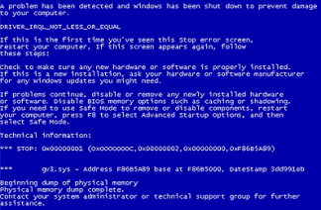
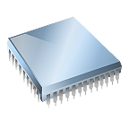
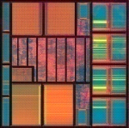
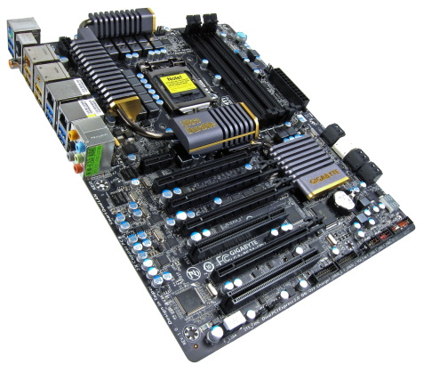

Post-silicon Validation
Run tests (e.g., OS, games)
Detect bugs
Quick Error Detection
[Lin, IEEE TCAD 14]
Weeks or Months
Manual work per bug
Root-cause & fix
Localize bugs
3

Slide 4
Bug Localization: BIG Problem
Detect bugs
Logic design bugs
Symbolic QED [Singh, IEEE TCAD 17]
Electrical bugs
E-QED: this paper
Focus on localization
Localize bugs
4
Notes:
Big problem: localization

Slide 5
E-QED
Automatic, overnight
vs. manual, weeks / months per bug
Fine-grained localization
From 1 million to 20 flip-flops
Scalable: billion-transistor design
Small area impact: 2.5% or less
Many ways to reduce area impact
5

Slide 6
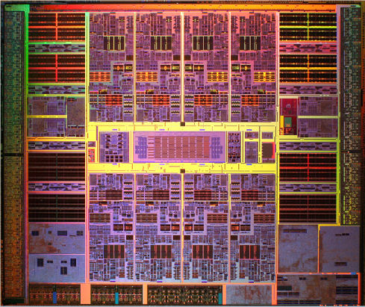
Problem Setup
Record
Test Inputs
Record
Test Outputs
Design RTL
Chip
// Memory Write Block
// Write Operation : When we_0 = 1, cs_0 = 1
always @ (address_0 or cs_0 or we_0 or data_0 47 or address_1 or cs_1 or we_1 or data_1)
begin : MEM_WRITE
if ( cs_0 && we_0 ) begin mem[address_0] <= data_0;
end else if (cs_1 && we_1) begin
mem[address_1] <= data_1;
end end
1
0
1
1
1
0
1
1
1
1
0
1
0
0
1
0
1
1
0
1
0
0
1
0
1
0
0
1
1
0
0
1
0
1
0
1
0
0
1
1
1
1
1
1
1
0
0
1
…
CRASH!
…
No electrical bug
Electrical bug
Inputs
Challenges
Design
Outputs
Failure reproduction difficult
Full system simulation infeasible
Large designs: too big for formal tools
Find
inconsistencies
Electrical bug candidates (e.g., flip-flops)
6

Slide 7
E-QED
Design phase: E-QED signature blocks
Run post-silicon validation tests
Localize error: formal methods
Notes:
E-QED relies on several steps during three stages.
During the chip design phase, E-QED signature blocks are automatically inserted. These E-QED signature blocks are used during post-silicon validation to capture and compress the logic values of selected signals (signatures).
During post-silicon validation, a suite of tests is run—it is crucial to run tests with short error-detection latencies (QED tests). When an error is detected by such a test, the test is immediately halted, and all the captured signatures are scanned out.
In the last phase the collected signatures are analyzed with formal techniques to
First identify which Design Module produced the error(s)
Then to find the FFs in that Module that could have captured the error(s)
Finally to narrow this list even further by checking for consistency with signatures captured by neighboring Design Modules

Slide 8
E-QED
Design phase: E-QED signature blocks
Run post-silicon validation tests
Localize error: formal methods
Notes:
E-QED relies on several steps during three stages.
During the chip design phase, E-QED signature blocks are automatically inserted. These E-QED signature blocks are used during post-silicon validation to capture and compress the logic values of selected signals (signatures).
During post-silicon validation, a suite of tests is run—it is crucial to run tests with short error-detection latencies (QED tests). When an error is detected by such a test, the test is immediately halted, and all the captured signatures are scanned out.
In the last phase the collected signatures are analyzed with formal techniques to
First identify which Design Module produced the error(s)
Then to find the FFs in that Module that could have captured the error(s)
Finally to narrow this list even further by checking for consistency with signatures captured by neighboring Design Modules

Slide 9
Design Phase
Too big for formal tools
Analyze modules separately
Module size = fit formal tool
Module A
Module
B
Module
C
Full
Design
Module D
Module E
Module F
9
Notes:
Restoration ratios, do not address bugs are gone by the time you look at it

Slide 10
Insert Additional Hardware
E-QED signature blocks
Module A
Module
B
Module
C
Module D
Module E
Module F
10
Notes:
Restoration ratios, do not address bugs are gone by the time you look at it

Slide 11
Trace Buffer vs MISR
Trace Buffer
Trace buffer
All values captured
Multiple Input Signature Register
Values compressed into signature
Area overhead
~L2 cache size
Captured values
Area overhead
2.5%
1
1
0
1
1
1
0
0
1
1
0
0
0
0
1
0 | 0 | 1
1 | 1 | 0
1 | 0 | 0
0 | 1 | 1
0
0
1
1
1
0
1
1 | 0 | 1
0
0
0
1
0
1
1
1
0
1
0
0
0
1
1
0
0
0
0
1
1
0
1
0
0
0
1
1
0
Trace buffer
MISR
11
Notes:
L2 cache -> largest component

Slide 12
E-QED
Design phase: E-QED signature blocks
Run post-silicon validation tests
Localize error: formal methods
Notes:
E-QED relies on several steps during three stages.
During the chip design phase, E-QED signature blocks are automatically inserted. These E-QED signature blocks are used during post-silicon validation to capture and compress the logic values of selected signals (signatures).
During post-silicon validation, a suite of tests is run—it is crucial to run tests with short error-detection latencies (QED tests). When an error is detected by such a test, the test is immediately halted, and all the captured signatures are scanned out.
In the last phase the collected signatures are analyzed with formal techniques to
First identify which Design Module produced the error(s)
Then to find the FFs in that Module that could have captured the error(s)
Finally to narrow this list even further by checking for consistency with signatures captured by neighboring Design Modules

Slide 13
Quick Error Detection Critical
Capture bug activation for formal analysis
Short error detection latency a must
< 1,000 cycles
Bug activated
Error occurred
Error
detected
Test
execution
Timeline
Error detection latency
Billions of cycles
13

Slide 14
Quick Error Detection
QED
[Lin, IEEE TCAD 14]
Bug activated
Error occurred
Error detected
Error
detected
Test
execution
Timeline
Error detection latency
Error detection latency
< 1,000 cycles
Billions of cycles
14
Notes:
No need to understand QED for E-QED

Slide 15
E-QED
Design phase: E-QED signature blocks
Run post-silicon validation tests
Localize error: formal methods
Notes:
E-QED relies on several steps during three stages.
During the chip design phase, E-QED signature blocks are automatically inserted. These E-QED signature blocks are used during post-silicon validation to capture and compress the logic values of selected signals (signatures).
During post-silicon validation, a suite of tests is run—it is crucial to run tests with short error-detection latencies (QED tests). When an error is detected by such a test, the test is immediately halted, and all the captured signatures are scanned out.
In the last phase the collected signatures are analyzed with formal techniques to
First identify which Design Module produced the error(s)
Then to find the FFs in that Module that could have captured the error(s)
Finally to narrow this list even further by checking for consistency with signatures captured by neighboring Design Modules

Slide 16

Localization to a Design Module
Run QED post-silicon test
Error detected
Module A
Module
B
Module
C
Start analysis: Module A
Module D
Module E
Module F
16
Notes:
Restoration ratios, do not address bugs are gone by the time you look at it

Slide 17
Localization to a Design Module
Capture window = number of cycles compressed
MISR periodically reset
Ensure capture window < 2,000 cycles
Module A
Input MISR
Output MISR
1 | 1 | 0 | 0 | 1 | 0
1 | 0 | 0 | 0 | 1 | 0
Capture window = 418 cycles
17
Notes:
Restoration ratios, do not address bugs are gone by the time you look at it

Slide 18
Localization to a Design Module
Bounded Model Checking: Module A
Module A
Input MISR
Output MISR
1 | 1 | 0 | 0 | 1 | 0
Module
RTL
1 | 0 | 0 | 0 | 1 | 0
Constrain
final input signature
Constrain
final output signature
BMC Tool
Unroll = 418 cycles
Capture window
18
Notes:
Restoration ratios, do not address bugs are gone by the time you look at it

Slide 19
Localization to a Design Module
Analyze Module A
Module A
Input MISR
Output MISR
1 | 1 | 0 | 0 | 1 | 0
Module
RTL
1 | 0 | 0 | 0 | 1 | 0
Constrain
final input signature
Constrain
final output signature
BMC Tool
✓
Signatures
consistent
19
Notes:
Restoration ratios, do not address bugs are gone by the time you look at it

Slide 20
Localization to a Design Module
Module A
Module
B
Module
C
Next: Module E
Module D
Module E
Module F
20
Notes:
Restoration ratios, do not address bugs are gone by the time you look at it

Slide 21
Localization to a Design Module
Setup and analyze: Module E
Module
E
Input MISR
Output MISR
1 | 1 | 1 | 0 | 1 | 0
Module
RTL
1 | 1 | 0 | 0 | 1 | 0
Constrain
final input signature
Constrain
final output signature
BMC Tool
Signatures inconsistent
Unroll = 418 cycles
Capture window
21
Notes:
Restoration ratios, do not address bugs are gone by the time you look at it

Slide 22
Localization to a Design Module
Setup and analyze: Module E
Module
E
Input MISR
Output MISR
1 | 1 | 1 | 0 | 1 | 0
1 | 1 | 0 | 0 | 1 | 0
Bug in Module E!
BMC Tool
22
Notes:
Restoration ratios, do not address bugs are gone by the time you look at it

Slide 23
Localization to a Design Module
Module A
Module
B
Module
C
✓
✓
✓
Module D
Module E
Module F
✓
✓
23
Notes:
Restoration ratios, do not address bugs are gone by the time you look at it

Slide 24
Localization to a Design Module
From 1 million to ~30,000 flip-flops
How can we do better?
24
Notes:
Restoration ratios, do not address bugs are gone by the time you look at it

Slide 25
Single Cycle Flip-Flop Error Model
Error source
Exactly one flip-flop
In exactly one clock cycle
Prior studies
[Mclaughlin, VTS 09;
Killpack, IEEE D&T 08; Mak, IEEE D&T 04]
25

Slide 26
Single Cycle Flip-Flop Error Localization
A
F₁
F₃
F₆
X
Module
E
F₄
F₇
Y
B
F₂
F₅
F₈
Z
Module E
1 | 1 | 1 | 0 | 1 | 0
1 | 1 | 0 | 0 | 1 | 0
Initial example: ignore MISRs
Input MISR
Output MISR
26
Notes:
Restoration ratios, do not address bugs are gone by the time you look at it

Slide 27
Single Cycle Flip-Flop Error Localization
Cycle 1
Cycle 2
Cycle 3
Cycle 4
1
1
0
1
A
F₁
F₃
F₆
X
0
1
1
F₄
F₇
Y
1
1
1
1
1
B
F₂
F₅
F₈
Z
1
Fault-free sequence
27
Notes:
Restoration ratios, do not address bugs are gone by the time you look at it

Slide 28
Single Cycle Flip-Flop Error Localization
Cycle 4
0
1
A
F₁
F₃
F₆
X
1
Error!
1
F₄
F₇
Y
1
1
B
F₂
F₅
F₈
Z
1
Potential candidate
Try F₆
Error at X
Candidate FFs
Cycle 4: F₆
28
Notes:
Restoration ratios, do not address bugs are gone by the time you look at it

Slide 29
Single Cycle Flip-Flop Error Localization
Cycle 4
Cycle 3
1
0
1
A
F₁
F₃
F₆
X
1
Error!
1
1
F₄
F₇
Y
1
1
1
B
F₂
F₅
F₈
Z
1
Potential candidate
Try F₃
Candidate FFs
Cycle 4: F₆
Cycle 3: F₃
29
Notes:
Restoration ratios, do not address bugs are gone by the time you look at it

Slide 30
Single Cycle Flip-Flop Error Localization
Cycle 2
Cycle 3
Cycle 4
0
1
0
1
A
F₁
F₃
F₆
X
1
0
0
F₄
F₇
Y
0
Different
Error!
1
1
1
B
F₂
F₅
F₈
Z
1
Not a Potential Candidate
Two final candidates
Try F₁
Candidate FFs
Cycle 4: F₆
Cycle 3: F₃
30
Notes:
Restoration ratios, do not address bugs are gone by the time you look at it

Slide 31
BMC Flip-Flop Localization
Modified RTL design – Only during BMC
For each flip-flop:
Original
Insert MUX
D Input
0
D
Q
1
S
BMC-controlled
Select
31
Notes:
Restoration ratios, do not address bugs are gone by the time you look at it

Slide 32
BMC Flip-Flop Localization
Find candidates: satisfy signature consistency
A
F₁
F₃
F₆
X
F₄
F₇
Y
B
F₂
F₅
F₈
Z
Module E
1 | 1 | 1 | 0 | 1 | 0
1 | 1 | 0 | 0 | 1 | 0
Input MISR
Output MISR
32
Notes:
Restoration ratios, do not address bugs are gone by the time you look at it

Slide 33
BMC Flip-Flop Localization
Return all satisfying flip-flop candidates
Trace | Candidates
1 | Cycle 3 FF3, Cycle 4 FF6
2 | Cycle 1 FF4, Cycle 2 FF7
BMC Tool
More aliased candidates
Multiple traces satisfy signatures
33
Notes:
Restoration ratios, do not address bugs are gone by the time you look at it

Slide 34
Aliased Traces
Trace 1
Trace 2
Z
Y
X
Z
Y
X
…
…
1 | 1 | 0
1 | 1 | 0
1 | 1 | 0
1 | 1 | 0
0 | 1 | 0
0 | 1 | 0
0 | 1 | 0
0 | 1 | 0
1 | 0 | 1
Trace 2 Injected Error
1 | 0 | 1
1 | 1 | 1
1 | 1 | 1
1 | 0 | 1
1 | 0 | 1
1 | 0 | 1
Trace 1 Injected Error
1 | 0 | 1
1 | 1 | 1
1 | 1 | 1
1 | 1 | 0
1 | 1 | 0
1 | 1 | 0 | 0 | 0 | 0
1 | 1 | 0 | 0 | 1 | 0
0 | 0 | 1 | 0 | 0 | 0
1 | 0 | 0 | 1 | 0 | 0
0 | 0 | 1 | 1 | 0 | 0
0 | 0 | 0 | 0 | 0 | 1
1 | 1 | 0 | 1 | 0 | 0
1 | 1 | 0 | 0 | 1 | 0
0 | 0 | 1 | 0 | 0 | 0
1 | 0 | 1 | 1 | 0 | 0
0 | 0 | 1 | 1 | 0 | 0
0 | 0 | 0 | 0 | 0 | 1
Output MISR
Output MISR
Final Signatures Match
34
Notes:
Restoration ratios, do not address bugs are gone by the time you look at it

Slide 35
Signature Error Localization
Reduce or remove aliased candidates?
Test traces in neighboring modules
Module A
Module
B
Module
C
Module D
Module E
Module F
35
Notes:
Restoration ratios, do not address bugs are gone by the time you look at it

Slide 36
Neighbor Consistency Checking
Test trace on Module D
Compare vs. captured neighbor signature
Module
E
Module
D
36
Notes:
Restoration ratios, do not address bugs are gone by the time you look at it

Slide 37
Neighbor Consistency Checking
Test Trace 1
Expected:
1 | 0 | 0 | 0 | 1 | 0
1
1
1
0
0
Module
E
Module
D
0
0
1
1
1
1
1
1
1
0
Trace | Candidates
1 | Cycle 3 FF3, Cycle 4 FF6
2 | Cycle 1 FF4, Cycle 2 FF7
✓
✓
1 | 0 | 0 | 0 | 1 | 0
37
Notes:
Restoration ratios, do not address bugs are gone by the time you look at it

Slide 38
Neighbor Consistency Checking
Test Trace 2
Expected:
1 | 0 | 0 | 0 | 1 | 0
1
1
0
0
0
Module
E
Module
D
0
0
1
1
1
1
1
1
1
0
Trace | Candidates
1 | Cycle 3 FF3, Cycle 4 FF6
2 | Cycle 1 FF4, Cycle 2 FF7
✓
0 | 1 | 0 | 0 | 1 | 1
38
Notes:
Restoration ratios, do not address bugs are gone by the time you look at it

Slide 39
Neighbor Consistency Checking
Only Trace 1 satisfies Module G
Module
E
Module
D
Trace | Candidates
1 | Cycle 3 FF3, Cycle 4 FF6
2 | Cycle 1 FF4, Cycle 2 FF7
✓
Rule out Trace 2
Candidates
39
Notes:
Restoration ratios, do not address bugs are gone by the time you look at it

Slide 40
E-QED Simulation Results
OpenSPARC T2
0.5 billion transistors
1 million flip-flops
Commercial version: Sun UltraSPARC T2
1,000,000 random bit errors
8 processor cores, crossbar interconnect
8 L2 cache controllers, 4 memory controllers
40
Notes:
Restoration ratios, do not address bugs are gone by the time you look at it

Slide 41
100% Design Module Localization
E-QED (min, average, max)
Buggy design module | Uniquely identified: 100%
41

Slide 42
50,000X Localization Factor
E-QED (min, average, max)
Buggy design module | Uniquely identified: 100%
Flip-flop Candidates (Out of ~1 million) | (5, 18, 26) flip-flops
Localization Factor =
Total flip-flops in design
Number of flip-flop candidates
42

Slide 43
Low Area Overhead
E-QED (min, average, max)
Buggy design module | Uniquely identified: 100%
Flip-flop Candidates (Out of ~1 million) | (5, 18, 26) flip-flops
Area Overhead | 2.5% or less
1.5% area overhead: ~70 flip-flop candidates
43

Slide 44
Overnight Localization
E-QED (min, average, max)
Buggy design module | Uniquely identified: 100%
Flip-flop Candidates (Out of ~1 million) | (5, 18, 26) flip-flops
Area Overhead | 2.5% or less
Debug Effort | Automatic
Runtime | (7, 8.7, 12) hours
44

Slide 45
Related Work
Observability
e.g.,
trace buffers, assertions in hardware
Bayazit 05, Abramovici 06, Anis 07, Vali 16, …
Observability ≠ localization
Expensive or limited benefits

Slide 46
Related Work
SAT for hardware debug
e.g.,
VLSI fault diagnosis, BackSpace derivatives
Sellers 68, Larrabee 92, De Paula 08, Zhu 11, …
Billion-transistor designs ?
Failure reproduction extremely difficult
Notes:
Boolean techniques for hardware debug have their foundation in the 1960s… first work on using Boolean analysis for debug
Tab-backspace for failure reproduction

Slide 47
Related Work
Data-driven debug
e.g.,
mining, bug positioning system
Li 10, De Orio 11,
Park 09, 10, …
False positives
Processor focus limited

Slide 48
Related Work
Observability
SAT for hardware debug
Data-driven debug
e.g.,
trace buffers, assertions in hardware
Bayazit 05, Abramovici 06, Anis 07, Vali 16, …
e.g.,
VLSI fault diagnosis, BackSpace derivatives
Sellers 68, Larrabee 92, De Paula 08, Zhu 11, …
e.g.,
mining, IFRA,
bug positioning system
Li 10, De Orio 11,
Park 09, 10, …
E-QED:
low-cost,
effective
E-QED:
scalable, fast,
no failure reproduction
E-QED:
no false positives,
arbitrary designs
E-QED complementary
Notes:
Nu-tab for rewrite rules
Backbones from princetion

Slide 49
Symbolic QED for Logic Bugs
Pre-silicon formal verification
20 mins. to 7 hours
Automatic: no property / constraint writing
Billion-transistor chips
[Lin ITC 15, Singh IEEE TCAD 17]
49

Slide 50


Acknowledgements

Slide 51

E-QED
Automatic, overnight
vs. manual, weeks / months per bug
Fine-grained localization
From 1 million to 20 flip-flops
Scalable: billion-transistor design
Small area impact: 2.5% or less
Many ways to reduce area impact
51
Notes:
Scales
Automatic
Very large
First result of it’s kind

Slide 52
Backups
52

Slide 53
E-QED signature block
Counter
Design Module Boundary
Reset 2
D
Q
D
Q
C
D
Q
Reset 1
….
D
Q
MISR 1
M
….
D
Q
D
Q
K
D
Q
Internal Logic
….
D
Q
MISR 2
D
Q
D
Q
D
Q
K
D
Q
….
Interface Clock
53
Notes:
Restoration ratios, do not address bugs are gone by the time you look at it

Slide 54
Signature Generator
Need 2 MISRs: alternating reset
Capture min N cycles, max 2N cycles
RST 1
RST 2
MISR 1
MISR 2
N
2N
3N
54
Notes:
Restoration ratios, do not address bugs are gone by the time you look at it

Slide 55
Full Results
 | Original tests (No QED) | New technique (after running QED versions of the original tests)
Number of Detected Errors | 2,832 | 12,555
Error Detection Latency (cycles) [Min, Avg, Max] | [793, 976K, 8.8M] | [19, 168, 763]
Number of flip-flop Candidates [Min, Avg, Max] | 9.3 * 10⁵ (~all flip-flops in the design) | [5, 18, 36]
Number of Bug Traces [Min, Avg, Max] | N/A | [1, 1, 1]
Number of bits in a bug trace [Min., Avg, Max] | N/A | [109kb, 483kb, 1.74Mb]
BMC Runtime (minutes) [Min., Avg, Max] | N/A | [420, 526, 772]
Total signature analyzer area overhead | N/A | 2.5%
Clock speed impact | N/A | ~ 0%
Localization Factor [Min, Avg, Max] | 1x | [26,067x, 52,133x, 187,680x]
55

Slide 56
Random Injection Statistics
Core | Number of Targeted FFs | 60,597
 | Number of Error Injections | 458,533
 | Number of Detected Errors | 3,872
 | Percentage of FFs with 1 Detected Error | 3.42%
L2C | Number of Targeted FFs | 18,369
 | Number of Error Injections | 138,997
 | Number of Detected Errors | 1,794
 | Percentage of FFs with 1 Detected Error | 5.53%
Crossbar | Number of Targeted FFs | 41,181
 | Number of Error Injections | 311,614
 | Number of Detected Errors | 3,576
 | Percentage of FFs with 1 Detected Error | 3.19%
MCU | Number of Targeted FFs | 12,007
 | Number of Error Injections | 90,856
 | Number of Detected Errors | 3,316
 | Percentage of FFs with 1 Detected Error | 12.78%
56

Slide 57
Core Results
 |  | Signature Localization | Single FF Error Localization | NCC Localization
Processor Core | Number of Traces [Min, Avg, Max] | N/A | [1, 3, 8] | [1, 1, 1]
 | Number of FF Candidates [Min, Avg, Max] | 63,428 | [11, 54, 91] | [8, 16, 29]
 | Avg. Localization Factor | 14x | 16,805x | 58,133x
 | BMC Runtime (minutes) [Min, Avg, Max] | [62, 74, 77] | [303,416,478] | [49, 85, 114]
57

Slide 58
Crossbar Results
 |  | Signature Localization | Single FF Error Localization | NCC Localization
Crossbar | Number of Traces [Min, Avg, Max] | N/A | [2, 12, 17] | [1, 1, 1]
 | Number of FF Candidates [Min, Avg, Max] | 41,521 | [31, 74, 130] | [5,23, 36]
 | Avg. Localization Factor | 21x | 12,263x | 40,440x
 | BMC Runtime (minutes) [Min, Avg, Max] | [53, 61, 72] | [379,421,450] | [54,142,205]
58

Slide 59
L2 Cache Results
 |  | Signature Localization | Single FF Error Localization | NCC Localization
L2 Cache | Number of Traces [Min, Avg, Max] | N/A | [2, 14, 19] | [1, 1, 1]
 | Number of FF Candidates [Min, Avg, Max] | 31,675 | [28, 77, 154] | [7, 19, 33]
 | Avg. Localization Factor | 41x | 11,786x | 48,954x
 | BMC Runtime (minutes) [Min, Avg, Max] | [51, 58, 64] | [468,504,535] | [42,187,242]
59

Slide 60
Memory Control Unit Results
 |  | Signature Localization | Single FF Error Localization | NCC Localization
Memory Control Unit | Number of Traces [Min, Avg, Max] | N/A | [3, 19, 24] | [1, 1, 1]
 | Number of FF Candidates [Min, Avg, Max] | 18,068 | [21, 67, 143] | [5, 11, 18]
 | Avg. Localization Factor | 72x | 13,544x | 84,557x
 | BMC Runtime (minutes) [Min, Avg, Max] | [35, 37, 41] | [315,387,428] | [78,163,251]
60

Slide 61
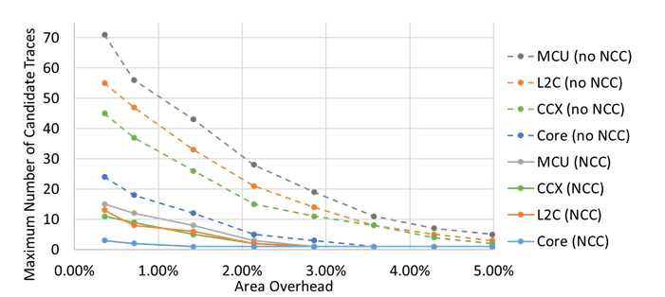
Area Overhead
Maximum number of unique candidate traces observed
Before and after Neighbor Consistency Checking (NCC)
For different area overheads
Varying the number of MISR bits per signal traced
61

Slide 62
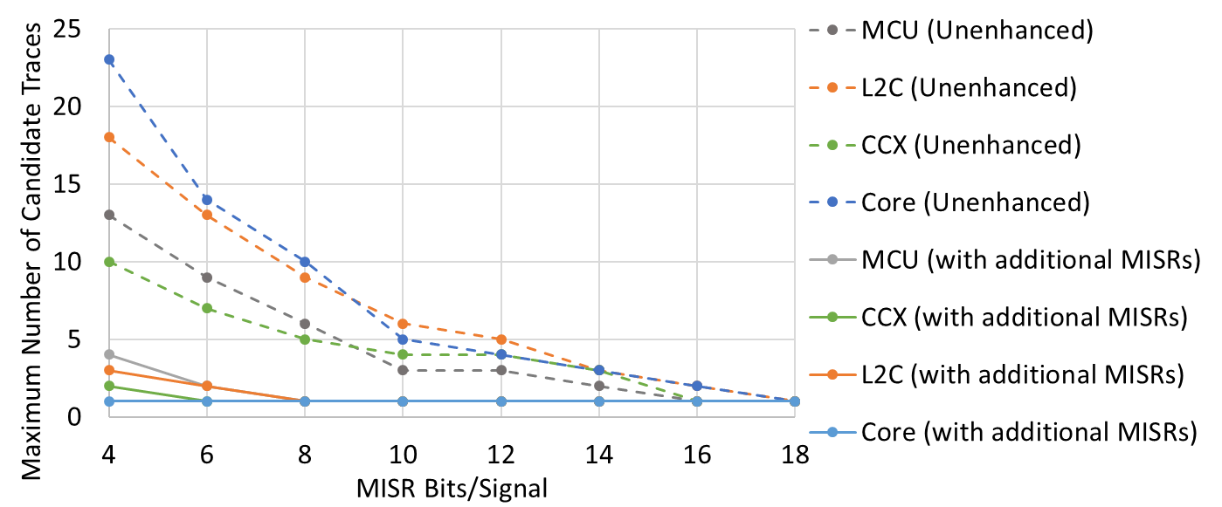
MISR Insertion Optimization
Maximum number of unique candidate traces observed after NCC
with and without additional MISRs
L2 cache banks, processor instruction fetch
For different MISR sizes (bits per signal traced)
62

Slide 63
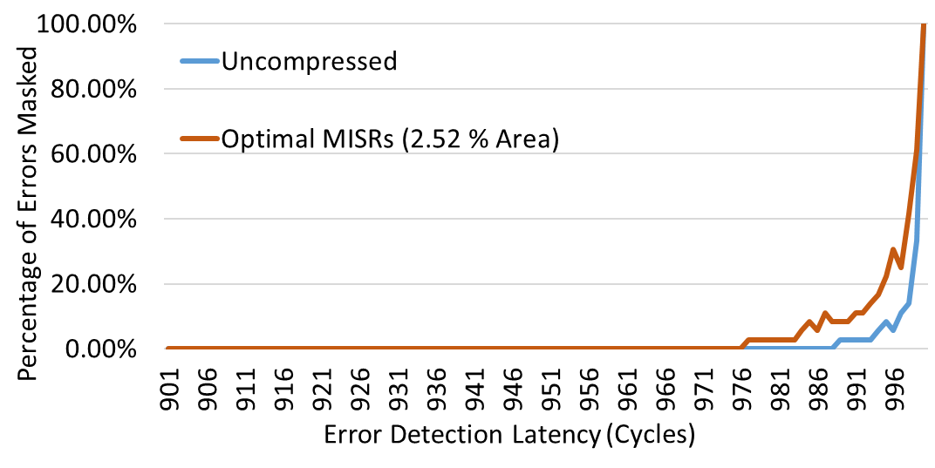
Errors masked by Initial States
Percentage of errors masked
By symbolic initialization of internal FFs
Formal analysis of 1,000 cycles prior to error detection
63

Slide 64
Runtime Comparison
Signature Cycles | Crossbar Arbiter (1,000 FFs) | L2C SubModule (5,000 FFs) | Memory Control Unit (20,000 FFs) | Processor (60,000 FFs)
5,000 | 47 | 351 | 1058 | 2623
10,000 | 139 | 993 | 2391 | 48 hr. Timeout
25,000 | 457 | 2103 | 48 hr. Timeout | 48 hr. Timeout
50,000 | 1472 | 48 hr. Timeout | 48 hr. Timeout | 48 hr. Timeout
100,000 | 48 hr. Timeout | 48 hr. Timeout | 48 hr. Timeout | 48 hr. Timeout
Runtime results for different sized Modules
Analyzed over 5,000 to 100,000 cycles
64

Slide 65
Oracle Injection Statistics
Core | Number of Targeted FFs | 60,597
 | Number of Error Injections | 500,000
 | Number of Detected Errors | 76,902
 | Percentage of FFs with at least 1 Detected Error | 21.67%
L2C | Number of Targeted FFs | 18,369
 | Number of Error Injections | 800,000
 | Number of Detected Errors | 157,211
 | Percentage of FFs with at least 1 Detected Error | 29.64%
Crossbar | Number of Targeted FFs | 41,181
 | Number of Error Injections | 800,000
 | Number of Detected Errors | 98,058
 | Percentage of FFs with at least 1 Detected Error | 18.02%
MCU | Number of Targeted FFs | 12,007
 | Number of Error Injections | 800,000
 | Number of Detected Errors | 184,853
 | Percentage of FFs with at least 1 Detected Error | 32.79%
65

Slide 66
Oracle Injection Results
 |  | Signature Localization | Single FF Error Localization | NCC Localization
Processor Core | Number of Traces | N/A | [1, 3, 8] | [1, 1, 1]
 | Number of Candidates | 63,428 | [7, 50, 101] | [7, 15, 31]
 | Avg. Localization Factor | 14x | 18,768x | 62,560x
 | BMC Runtime (minutes) | [62, 74, 77] | [287,423,486] | [49, 85, 114]
L2 Cache | Number of Traces | N/A | [2, 13, 21] | [1, 1, 1]
 | Number of Candidates | 31,675 | [25, 79, 159] | [7, 20, 35]
 | Avg. Localization Factor | 41x | 11,879x | 46,920x
 | BMC Runtime (minutes) | [46, 58, 67] | [442,501,548] | [42,187,242]
Crossbar | Number of Traces | N/A | [1, 12, 17] | [1, 1, 1]
 | Number of Candidates | 41,521 | [31, 74, 130] | [5,21, 38]
 | Avg. Localization Factor | 21x | 12,681x | 44,686x
 | BMC Runtime (minutes) | [51, 61, 79] | [357,416,467] | [54,142,205]
Memory Control Unit | Number of Traces | N/A | [2, 18, 25] | [1, 1, 1]
 | Number of Candidates | 18,068 | [21, 67, 143] | [5, 11, 18]
 | Avg. Localization Factor | 72x | 14,006x | 85,309x
 | BMC Runtime (minutes) | [32, 34, 47] | [315,387,428] | [78,163,251]
66

Slide 67
BMC Bit Error Localization
Model
Design RTL
Modified to inject 1 bit error in 1 cycle
Property
After N cycles (from counter)
Inputs = Input Signature && Outputs = Output Signature
67
Notes:
Restoration ratios, do not address bugs are gone by the time you look at it

Slide 68
BMC Bit Error Localization
Modified design – enable single bit error
For each FF:
Insert MUX
Original
D Input
0
D
Q
1
FF N
S
Error Bit
Select for FF N
68
Notes:
Restoration ratios, do not address bugs are gone by the time you look at it

Slide 69
BMC Bit Error Localization
Modified design: Model for BMC
Error
Selects
Bit Error Control
Bit error control
Reset
K
Module with MUXes
for all K FFs
BMC control signals
Output
Signature
Input
Signature
Only for BMC: Fabricated design unchanged
69
Notes:
Restoration ratios, do not address bugs are gone by the time you look at it

Slide 70
Bit-flip Localization
LFSR Signature → localization constraint
Bit Error Control
Bit error control
Module D
Reset
with MUXes
for all K FFs
Module Output Signature
Module Input Signature
Test BMC property
Inputs = Input Signature && Outputs = Output Signature
Find bit-flip candidates
70
Notes:
Restoration ratios, do not address bugs are gone by the time you look at it

Slide 71
BMC Bit Error Localization
BMC Result
Multiple runs: Candidate list of FFs
Cycle 84: FF 383
Cycle 96: FF 2380
Cycle 96: FF 2383
Cycle 121: FF 1107
Cycle 148: FF 654
Cycle 149: FF 682
FF # → Bit error Control Value
At the given cycle:
FF bit error causes traced (incorrect) output
71
Notes:
Restoration ratios, do not address bugs are gone by the time you look at it

Slide 72
QED Transforms
Processor cores
Uncore, accelerators
EDDI-V
CFTSS-V
CFCSS-V
PLC
Fast QED
Hybrid QED
72

Slide 73

QED Example: Duplicate & Check
Validation program
Trace
void matgen (REAL a[], int lda, int n, REAL b[], REAL *norma)
{
int init, i, j;
init = 1325;
*norma = 0.0;
for (j = 0; j < n; j++) {
for (i = 0; i < n; i++) {
init = 3125*init % 0x100000000l;
a[lda*j+i] = (init - 32768.0)/16384.0;
*norma = (a[lda*j+i] > *norma) ? a[lda*j+i] : *norma;
}
}
for (i = 0; i < n; i++) {
b[i] = 0.0;
}
for (j = 0; j < n; j++) {
for (i = 0; i < n; i++) {
b[i] = b[i] + a[lda*j+i];
}
}
return;
}
void dgefa(REAL a[], int lda, int n, int ipvt[], int *info){
/* internal variables */
REAL t;
int j,k,kp1,l,nm1;
/* gaussian elimination with partial pivoting */
*info = 0;
nm1 = n - 1;
if (nm1 >= 0) {
for (k = 0; k < nm1; k++) {
kp1 = k + 1;
/* find l = pivot index */
l = idamax(n-k,&a[lda*k+k],1) + k;
ipvt[k] = l;
/* zero pivot implies this column already
triangularized */
if (a[lda*k+l] != ZERO) {
/* interchange if necessary */
if (l != k) {
t = a[lda*k+l];
a[lda*k+l] = a[lda*k+k];
a[lda*k+k] = t;
}
/* compute multipliers */
t = -ONE/a[lda*k+k];
dscal(n-(k+1),t,&a[lda*k+k+1],1);
/* row elimination with column indexing */
for (j = kp1; j < n; j++) {
t = a[lda*j+l];
if (l != k) {
a[lda*j+l] = a[lda*j+k];
a[lda*j+k] = t;
}
daxpy(n-(k+1),t,&a[lda*k+k+1],1,
&a[lda*j+k+1],1);
}
}
else {
*info = k;
}
}
}
ipvt[n-1] = n-1;
if (a[lda*(n-1)+(n-1)] == ZERO) *info = n-1;
checkExpected(a, ipvt, info);
return;
}
void dgesl(REAL a[],int lda,int n,int ipvt[],REAL b[],int job )
{
REAL t;
int k,kb,l,nm1;
nm1 = n - 1;
if (job == 0) {
/* job = 0 , solve a * x = b
first solve l*y = b */
if (nm1 >= 1) {
for (k = 0; k < nm1; k++) {
l = ipvt[k];
t = b[l];
if (l != k){
b[l] = b[k];
b[k] = t;
}
daxpy(n-(k+1),t,&a[lda*k+k+1],1,&b[k+1],1 );
}
}
/* now solve u*x = y */
for (kb = 0; kb < n; kb++) {
k = n - (kb + 1);
b[k] = b[k]/a[lda*k+k];
t = -b[k];
daxpy(k,t,&a[lda*k+0],1,&b[0],1 );
}
}
else {
R1 ← R1 + 5
R2 ← R2 – R1
R3 ← R1 * R2
Very
Long!
Check end_result
73
Notes:
73

Slide 74
QED Example: Duplicate & Check
Validation program
QED Trace
void matgen (REAL a[], int lda, int n, REAL b[], REAL *norma)
{
int init, i, j;
init = 1325;
*norma = 0.0;
for (j = 0; j < n; j++) {
for (i = 0; i < n; i++) {
init = 3125*init % 0x100000000l;
a[lda*j+i] = (init - 32768.0)/16384.0;
*norma = (a[lda*j+i] > *norma) ? a[lda*j+i] : *norma;
}
}
for (i = 0; i < n; i++) {
b[i] = 0.0;
}
for (j = 0; j < n; j++) {
for (i = 0; i < n; i++) {
b[i] = b[i] + a[lda*j+i];
}
}
return;
}
void dgefa(REAL a[], int lda, int n, int ipvt[], int *info){
/* internal variables */
REAL t;
int j,k,kp1,l,nm1;
/* gaussian elimination with partial pivoting */
*info = 0;
nm1 = n - 1;
if (nm1 >= 0) {
for (k = 0; k < nm1; k++) {
kp1 = k + 1;
/* find l = pivot index */
l = idamax(n-k,&a[lda*k+k],1) + k;
ipvt[k] = l;
/* zero pivot implies this column already
triangularized */
if (a[lda*k+l] != ZERO) {
/* interchange if necessary */
if (l != k) {
t = a[lda*k+l];
a[lda*k+l] = a[lda*k+k];
a[lda*k+k] = t;
}
/* compute multipliers */
t = -ONE/a[lda*k+k];
dscal(n-(k+1),t,&a[lda*k+k+1],1);
/* row elimination with column indexing */
for (j = kp1; j < n; j++) {
t = a[lda*j+l];
if (l != k) {
a[lda*j+l] = a[lda*j+k];
a[lda*j+k] = t;
}
daxpy(n-(k+1),t,&a[lda*k+k+1],1,
&a[lda*j+k+1],1);
}
}
else {
*info = k;
}
}
}
ipvt[n-1] = n-1;
if (a[lda*(n-1)+(n-1)] == ZERO) *info = n-1;
checkExpected(a, ipvt, info);
return;
}
void dgesl(REAL a[],int lda,int n,int ipvt[],REAL b[],int job )
{
REAL t;
int k,kb,l,nm1;
nm1 = n - 1;
if (job == 0) {
/* job = 0 , solve a * x = b
first solve l*y = b */
if (nm1 >= 1) {
for (k = 0; k < nm1; k++) {
l = ipvt[k];
t = b[l];
if (l != k){
b[l] = b[k];
b[k] = t;
}
daxpy(n-(k+1),t,&a[lda*k+k+1],1,&b[k+1],1 );
}
}
/* now solve u*x = y */
for (kb = 0; kb < n; kb++) {
k = n - (kb + 1);
b[k] = b[k]/a[lda*k+k];
t = -b[k];
daxpy(k,t,&a[lda*k+0],1,&b[0],1 );
}
}
else {
R16 ← R1; R18 ← R2; R19 ← R3
R1 ← R1 + 5
Quick!
R16 ← R16 + 5
R1 == R16
R2 ← R2 – R1
R18 ← R18 – R16
R2 == R18
R3 ← R1 * R2
R19 ← R16 * R18
R3 == R19
Check end_result
74
Notes:
74

Slide 75
Diversity-Enhanced QED
Validation program
QED Trace
void matgen (REAL a[], int lda, int n, REAL b[], REAL *norma)
{
int init, i, j;
init = 1325;
*norma = 0.0;
for (j = 0; j < n; j++) {
for (i = 0; i < n; i++) {
init = 3125*init % 0x100000000l;
a[lda*j+i] = (init - 32768.0)/16384.0;
*norma = (a[lda*j+i] > *norma) ? a[lda*j+i] : *norma;
}
}
for (i = 0; i < n; i++) {
b[i] = 0.0;
}
for (j = 0; j < n; j++) {
for (i = 0; i < n; i++) {
b[i] = b[i] + a[lda*j+i];
}
}
return;
}
void dgefa(REAL a[], int lda, int n, int ipvt[], int *info){
/* internal variables */
REAL t;
int j,k,kp1,l,nm1;
/* gaussian elimination with partial pivoting */
*info = 0;
nm1 = n - 1;
if (nm1 >= 0) {
for (k = 0; k < nm1; k++) {
kp1 = k + 1;
/* find l = pivot index */
l = idamax(n-k,&a[lda*k+k],1) + k;
ipvt[k] = l;
/* zero pivot implies this column already
triangularized */
if (a[lda*k+l] != ZERO) {
/* interchange if necessary */
if (l != k) {
t = a[lda*k+l];
a[lda*k+l] = a[lda*k+k];
a[lda*k+k] = t;
}
/* compute multipliers */
t = -ONE/a[lda*k+k];
dscal(n-(k+1),t,&a[lda*k+k+1],1);
/* row elimination with column indexing */
for (j = kp1; j < n; j++) {
t = a[lda*j+l];
if (l != k) {
a[lda*j+l] = a[lda*j+k];
a[lda*j+k] = t;
}
daxpy(n-(k+1),t,&a[lda*k+k+1],1,
&a[lda*j+k+1],1);
}
}
else {
*info = k;
}
}
}
ipvt[n-1] = n-1;
if (a[lda*(n-1)+(n-1)] == ZERO) *info = n-1;
checkExpected(a, ipvt, info);
return;
}
void dgesl(REAL a[],int lda,int n,int ipvt[],REAL b[],int job )
{
REAL t;
int k,kb,l,nm1;
nm1 = n - 1;
if (job == 0) {
/* job = 0 , solve a * x = b
first solve l*y = b */
if (nm1 >= 1) {
for (k = 0; k < nm1; k++) {
l = ipvt[k];
t = b[l];
if (l != k){
b[l] = b[k];
b[k] = t;
}
daxpy(n-(k+1),t,&a[lda*k+k+1],1,&b[k+1],1 );
}
}
/* now solve u*x = y */
for (kb = 0; kb < n; kb++) {
k = n - (kb + 1);
b[k] = b[k]/a[lda*k+k];
t = -b[k];
daxpy(k,t,&a[lda*k+0],1,&b[0],1 );
}
}
else {
a ← 1; a' ← a; b ← 1, b' ← b
6 2
R1 ← a + b
R1
14 10
R18 ← 5a' + 5b'
R18
5×R1 == R18
Many diversity techniques
e.g., ED⁴I [Oh IEEE Trans. Comp. 02]
75
Notes:
75

Slide 76
Signature Generator
To provide initial signature value for BMC
Must reset signature generator periodically
Is one signature enough? NO
Example: 1000 cycle signature window
500 cycle bug detection latency
50% probability of capturing the bug
76

Slide 77
Case Study on Speed Failure Causes in a Microprocessor , IEEE D&T 2008
Kip Killpack, Suriyaprakash Natarajan, and Arun Krishnamachary Intel
Pouria Bastani UCSB
New challenges in delay testing of nanometer, multigigahertz designs, IEEE D&T 2004
T.M. Mak Intel
A. Krstic Cadence
K.-T. Cheng, Li.-C. Wang UCSB

